Slide 1
Mirroring

Slide 2
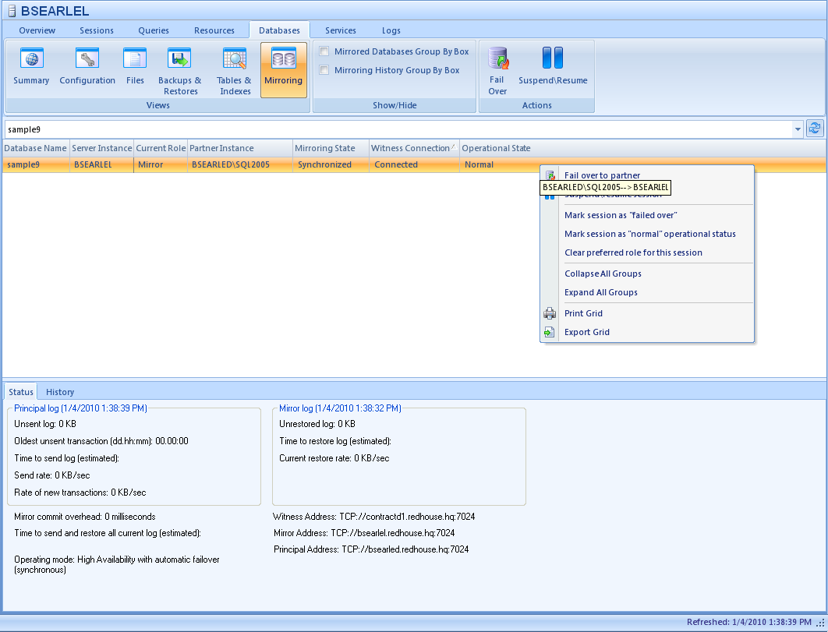
Mirroring View

Slide 3
Tables
MirroringParticipants
Mirroring GUID
Role
Principal address
Mirror Address
Witness address
……
MirroringPreferredConfig
Principal Server ID
Mirror Server ID
Witness Address
Normal (bit) – config represents normal or failed over
MirroringStatistics
Guid
DatabaseID (ServerID is derived from this)
Time
Role
State
Witness State
Log generation rate
Unsent log
Send rate
Un-restored log
……..

Slide 4
Setting mirroring up
Ensure that the SQL Server service is running under an account with rights to the partner server.
The error that you get if this is not the case will be deceptive. It will tell you that the server does not exist or the port is not open,
You have to back up the database and the log and then restore them both to the mirror with norecovery.
Don’t bother trying without the log restore although MS does not say it is a requirement.
Beware of symantec endpoint protection

Slide 5
Probes
ScheduledRefresh
MirroredDatabaseScheduled2005.sql
MirrorMonitoringHistoryProbe
MirrorMonitoringHistory2005.sql
sp_dbmmonitorresults
MirrorMonitoringRealtimeProbe
Selected from sys.database_mirroring
ServerActionProbe
MirrorPartnerAction.sql

Slide 6
Preferred configuration
Preferred configuration is kept in the workload for the server.
The returned configuration is compared to the preferred configuration and an alert is fired if there is a change (if enabled).
If a server is deleted it gets removed from the workload list of preferred configs, and also from the repository.

Slide 7
Background workers
Fail over to partner
ServerActionProbe
MirroringPartnerActionsCollector
Suspend \ resume mirroring
ServerActionProbe
MirroringPartnerActionsCollector
Refresh mirroring details
MirrorMonitoringRealtimeProbe
MirrorMonitoringRealtime2005
Refresh partner detailsProbe
MirrorMonitoringRealtime
MirrorMonitoringRealtime2005
Refresh History
MirrorMonitoringHistoryProbe
MirrorMonitoringHistory2005
Set operational status
Set session preferred configuration in the workload of the principal.
Set session preferred configuration in the workload of the mirror.
ManagementService saves preferred configuration to the repository.

